Slide 1
Mentoring the mentors workshop for HIV researchers May 18-19, 2015, San Francisco
For mentors interested in nurturing early career investigators from diverse backgrounds in HIV research
Giving and Receiving Feedback
May 18, 2015
Clyde Evans, PhD
President
CE Consulting

Slide 2
Working with Faculty Continuum
Giving and Receiving Feedback
Performance Appraisal
Developing Faculty
Mentoring and Coaching

Slide 3
Working with Faculty Continuum
Feedback--sharing of information
Performance appraisal--assessing task achievement
Mentoring/coaching-personally facilitating individual success or advancement

Slide 4
My Assumptions
You know more than you realize.
Let’s build on that and enhance it so you can be more intentional/planful/strategic.

Slide 5
Two questions
1. How many of you receive good, consistent feedback from the people with whom you currently work?
2. How many of you give good, consistent feedback to the people with whom you currently work?
In each case, why do you think that is?

Slide 6
Feedback Exercise
Hold your hands just above your desk and try to recall the number of times that you have received valuable feedback during the last 7 days. For each occasion that you RECEIVED valuable feedback, place one finger of your left hand on the desk. For each occasion that you have GIVEN valuable feedback, place one finger of your right hand on your desk. Now look at your fingers.
Did you run out of fingers or are they still hovering in the air?
Now look at your colleagues’ fingers.

Slide 7
FEEDBACK
What’s the first thing that comes to mind?

Slide 8
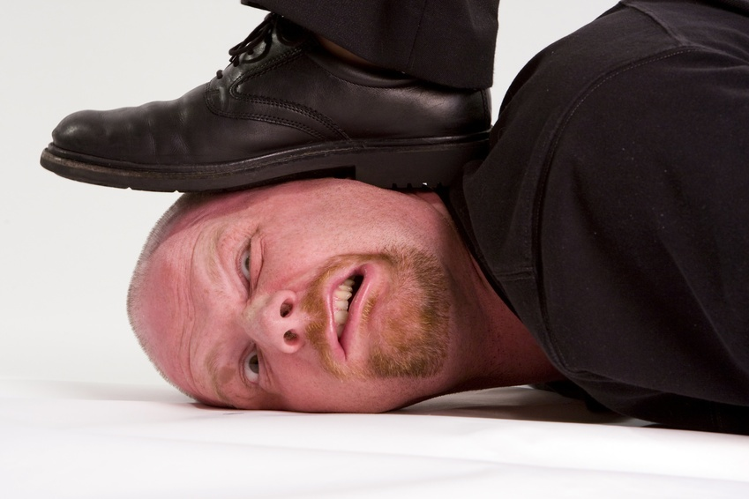
How do you really feel about feedback?

Slide 9
Some Rhetorical Questions About Feedback
Is feedback always negative? (Answer with your gut, not your brain.)
Is feedback the same as criticism?
Does feedback always imply a superior-subordinate relationship?
Will someone accept negative feedback from you, if you’ve never given them positive feedback?

Slide 10
Feedback Exercise
Recall a memorable feedback experience
You get to say what “memorable” means.

Slide 11
Feedback Exercise Debrief: Part 1
Was it giving or receiving?
What made it memorable?
What, if anything, could have made it better?
What did you personally take away about feedback from that experience?
Discuss in pairs

Slide 12
Feedback Exercise Debrief: Part 2
In small groups, convert your lessons learned into tips and guidelines for giving feedback
DOs DON’Ts
1. 1.
2. 2.
3. 3.

Slide 13
Reflection 1
How do you personally stack-up vis-à-vis these DOs and DON’Ts?
Do you see specific areas where you would like to improve?
How do you handle the “hard cases”?
How do your decide when to give feedback and when to keep quiet?

Slide 14
Mini Case Study
Two colleagues, Dr. Maxim and Dr. Lao, have just presented their research results at a conference. A question from the audience challenges the pair’s conclusions. Dr. Maxim responds defensively because he “heard” and “experienced” the challenge as an attack. Dr. Lao jumps into the discussion with a very different attitude; she welcomes the challenge and is eager to debate the data that led to the conclusion.
NIH Field Guide
Collaboration and Team Science

Slide 15
Mini Case Study
What feedback would you give if Dr. Lao were your mentee? What would you say?
What feedback would you give if Dr. Maxim were your mentee? What would you say?

Slide 16
Feedback Video

Slide 17
Reflection 2
What would be the most meaningful or valuable feedback you could receive from one of your colleagues?

Slide 18
Reflection 2
What would be the most meaningful or valuable feedback you could receive from one of your colleagues?
What would be the most meaningful or valuable feedback you could give your mentee?

Slide 19
Reflection 2
What would be the most meaningful or valuable feedback you could receive from one of your colleagues?
What would be the most meaningful or valuable feedback you could give your mentee?
What would be the most meaningful or valuable feedback you could receive from your mentor [answered by your mentee]?

Slide 20
What does literature/research say about
Good Feedback
Bad Feedback

Slide 21
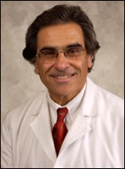
Seven Characteristics of Effective Feedback (One Person’s List)
Descriptive and non-evaluative
Specific
Behaviorally anchored
Well-timed
Limited in quantity
Positive as well as corrective
Anticipatory guidance
Ende J. Feedback in clinical medical education. JAMA: 1983: 250:777-781.

Slide 22
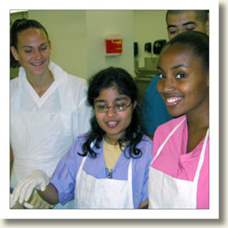
General Principles about Feedback
“Consistent, objective and timely feedback on performance is the educational intervention
Most likely to produce meaningful change in the behavior of professional trainees.”
-Davis DA, 1992
“Feedback is second only to competency of faculty.”
-Wolverton S, Bosworth M. 1985.
Fam Medicine clerkship at Duke
Feedback lowest rated by students over 10-year period
- Kaprielian VS, Gradison M. 1998.

Slide 23
General Principles cont’d
Manner in which feedback is given strongly affected perceptions of helpfulness
Feedback given supportively
Being gentle and not hitting someone over the head with their mistakes
Hewson MG & Little ML. 1998

Slide 24
Unhelpful Feedback Techniques
based on different goals than the other person’s
from someone who projected his/her own issues onto the other person
perceived as personal judgments
in public setting
Hewson & Little

Slide 25
Helpful Feedback Strategies
Identify learning objectives
Provide orientation during first encounter
Make environment “safe”
Assess performance, not person
Respond to learner’s self assessment
Be objective

Slide 26
More helpful strategies
Begin with "I" statements
Balance negative & positive
Anchor feedback to common goals
Provide for two-way communication
Feedback must be actionable
Feedback must be valuable

Slide 27
Helpful Feedback Strategies cont’d
Give as soon after event/incident as possible
Start with what went well
Try to give one-to-one
Focus upon observed behavior
Explore alternative behaviors with trainee
Donnelly & Kirk

Slide 28
Helpful Feedback Strategies cont’d
Brief
Trustworthy and honest
Private
Normal part of teaching/learning process
Provide for follow-up

Slide 29
Getting Feedback
An old adage – “You don’t ask, you don’t get.” If a boss doesn’t give feedback, shame on her/him. If you don’t ask for it, shame on you. * Evaluate Yourself – think about your own view first * Pick Your Spots – know when and where to ask each person * Make It Matter – don’t ask on everything, pick key stuff * Get Specific – ask what worked and what to work on * Offer Thanks – courtesy and appreciation go a long way in business
(Andrew Bergin at http://owningthestagecoach.blogspot.com, reproduced with permission.)

Slide 30
Giving Feedback
Follow a time honored HR tip – “Feedback should be about a person’s performance or behavior, not about them as a person”. Respect counts. * Be Prepared – avoid ‘shoot from the lip’ feedback * Be Specific – vague feedback gives one nothing to work on * Ditch the Dump Truck – people can change 1 thing, not 12 * Focus on Facts – make it personal and you lose credibility * Watch Your Language – substitute “and” for “but” * Refuse to Dance – don’t return emotion with emotion

Slide 31
Receiving Feedback
“Feedback is the breakfast of champions”. Great performers use feedback to raise the level of their game. * Open Your Mind – don’t get stuck in preconceptions * Listen Well – don’t interrupt; play it back for clarity * Write It Down Afterwards – what’s the use if you can’t remember? * Gauge Its Relevance – to yourself and your role * Do Something With It – if you don’t apply it, don’t ask again

Slide 32
360 Degree Feedback
Known to Self
Unknown to Self
Public Self | Blind Spots
Hidden Self | Unconscious Self
Known to Others
Unknown to Others
Johari’s Window
Notes:
Unconscious self—between you and your analyst
Hidden self—between you and your confessor
Public self—the face you choose to put on
Blind spots—you may be the last to know……..BUT this is where you can learn and get better

Slide 33
Take Away Lessons
What would make YOU better at giving feedback?
1.
2.
3.
4.

